Slide 1
GREEDY ALGORITHMS
Dr. A.Kannan,
(Retired Professor, Anna University,Chennai)
Senior Professor,
School of Computer Science and Engineering,
VIT, VELLORE.

Slide 2
GREEDY ALGORITHMS
A greedy algorithm is a simple, intuitive algorithm that is used in optimization problems.
The algorithm makes the optimal choice at each step as it attempts to find the overall optimal way to solve the entire problem.
Suppose it is possible to build a solution to a problem through a sequence of partial solutions:
At each step, we focus on one particular partial solution and we attempt to extend that solution.
Ultimately, the partial solutions should lead to a feasible solution which is also optimal.

Slide 3
GREEDY ALGORITHMS
Coin problem
Knapsack problem
Traveling salesman problem
Greedy algorithms for finding the shortest path include:
Prim’s algorithm
Kruskal’s algorithm
Dijkstra’s algorithm

Slide 4
HEURISTIC SEARCH ALGORITHMS
Depth First - Application
Breadth First
Hill Climbing
Genetic Algorithms
Best First Search
A* Algorithm
AO* Algorithm

Slide 5
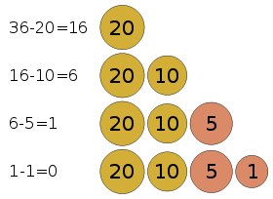
Coin problem
Task: Given a coin set, pay the required amount (36 snt) using least number of coins.

Slide 6
Coin problem
Consider this commonplace example:
Making the exact change with the minimum number of coins
Consider the Euro denominations of 1, 2, 5, 10, 20, 50 cents
Stating with an empty set of coins, add the largest coin possible into the set which does not go over the required amount

Slide 7
Knapsack Problem
You are given the following-
A knapsack (kind of shoulder bag) with limited weight capacity.
Few items each having some weight and value.
The problem states-
Which items should be placed into the knapsack such that
the value or profit obtained by putting the items into the knapsack is maximum.
And the weight limit of the knapsack does not exceed the capacity.

Slide 8
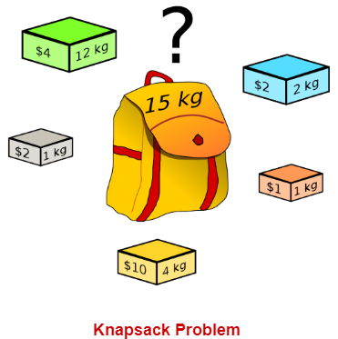
Knapsack Problem

Slide 9
Knapsack Problem Variants
Knapsack problem has the following two variants-
1. Fractional Knapsack Problem
2. 0/1 Knapsack Problem
In this session, we will see about 0/1 Knapsack Problem.

Slide 10
0/1 Knapsack Problem
In 0/1 Knapsack Problem,
As the name suggests, items are indivisible here.
We cannot take the fraction of any item.
We have to either take an item completely or leave it completely.
It is solved using dynamic programming approach.

Slide 11
0/1 Knapsack Problem Using Dynamic Programming
Consider-
Knapsack weight capacity = w
Number of items each having some weight and value = n
0/1 knapsack problem is solved using dynamic programming in the following steps:
Step-01:
Draw a table say ‘T’ with (n+1) number of rows and (w+1) number of columns.
Fill all the boxes of 0th row and 0th column with zeroes as shown-

Slide 12
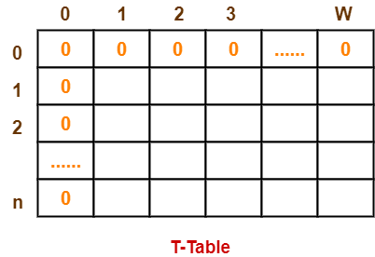
0/1 Knapsack Problem Using Dynamic Programming Contd..

Slide 13
0/1 Knapsack Problem Using Dynamic Programming Contd..
Step-02:
Start filling the table row wise top to bottom from left to right using the following formula:
T (i , j) = max { T ( i-1 , j ) , value_{i} + T( i-1 , j – weight_{i} ) }
Here, T(i , j) = maximum value of the selected items if we can take items 1 to i and have weight restrictions of j.
This step leads to completely filling the table.
Then, value of the last box represents the maximum possible value that can be put into the knapsack.

Slide 14
0/1 Knapsack Problem Using Dynamic Programming Contd..
Step-03:
To identify the items that must be put into the knapsack to obtain that maximum profit,consider the last column of the table.
Start scanning the entries from bottom to top.
On encountering an entry whose value is not same as the value stored in the entry immediately above it, mark the row label of that entry.
After all the entries are scanned, the marked labels represent the items that must be put into the knapsack.

Slide 15
0/1 Knapsack Problem Using Dynamic Programming Contd..
Time Complexity-
Each entry of the table requires constant time θ(1) for its computation.
It takes θ(nw) time to fill (n+1)(w+1) table entries.
It takes θ(n) time for tracing the solution since tracing process traces the n rows.
Thus, overall θ(nw) time is taken to solve 0/1 knapsack problem using dynamic programming.

Slide 16
0/1 Knapsack Problem Using Dynamic Programming Contd..
PRACTICE PROBLEM BASED ON 0/1 KNAPSACK PROBLEM:
For the given set of items and knapsack capacity = 5 kg, find the optimal solution for the 0/1 knapsack problem making use of dynamic programming approach.

Slide 17
PRACTICE PROBLEM BASED ON 0/1 KNAPSACK PROBLEM Contd..
Item | Weight | Value
1 | 2 | 3
2 | 3 | 4
3 | 4 | 5
4 | 5 | 6

Slide 18
PRACTICE PROBLEM BASED ON 0/1 KNAPSACK PROBLEM Contd..
OR
Find the optimal solution for the 0/1 knapsack problem making use of dynamic programming approach. Consider-
n = 4
w = 5 kg
(w1, w2, w3, w4) = (2, 3, 4, 5)
(b1, b2, b3, b4) = (3, 4, 5, 6)

Slide 19
PRACTICE PROBLEM BASED ON 0/1 KNAPSACK PROBLEM Contd..
Given-
Knapsack capacity (w) = 5 kg
Number of items (n) = 4
Step-01:
Draw a table say ‘T’ with (n+1) = 4 + 1 = 5 number of rows and (w+1) = 5 + 1 = 6 number of columns.
Fill all the boxes of 0th row and 0th column with 0.

Slide 20
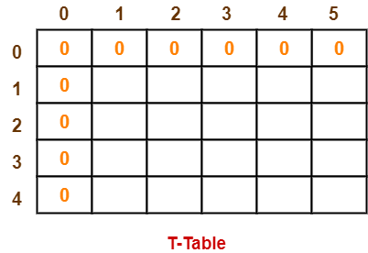
PRACTICE PROBLEM BASED ON 0/1 KNAPSACK PROBLEM Contd..

Slide 21
PRACTICE PROBLEM BASED ON 0/1 KNAPSACK PROBLEM Contd..
Step-02:
Start filling the table row wise top to bottom from left to right using the formula:
T (i , j) = max { T ( i-1 , j ) , value_{i} + T( i-1 , j – weight_{i} ) }
T(1,1)= Max{T(0,1), 3 + T(0, -1) }
T(1,1)= Max { T(0,1), 3 + Ignore} = Max(0, Ignore) = 0
Finding T(1,1):
We have,
i = 1
j = 1
(value)_{i} = (value)₁ = 3
(weight)_{i} = (weight)₁ = 2

Slide 22
PRACTICE PROBLEM BASED ON 0/1 KNAPSACK PROBLEM Contd..
Substituting the values, we get-
T(1,1) = max { T(1-1 , 1) , 3 + T(1-1 , 1-2) }
T(1,1) = max { T(0,1) , 3 + T(0,-1) }
T(1,1) = T(0,1) { Ignore T(0,-1) }
T(1,1) = 0

Slide 23
Finding T(1,2)
We have,
i = 1, j = 2
(value)_{i} = (value)₁ = 3
(weight)_{i} = (weight)₁ = 2
Substituting the values, we get-
T(1,2) = max { T(1-1 , 2) , 3 + T(1-1 , 2-2) }
T(1,2) = max { T(0,2) , 3 + T(0,0) }
T(1,2) = max {0 , 3+0}
T(1,2) = 3

Slide 24
Finding T(1,3)
We have,
i = 1, j = 3
(value)_{i} = (value)₁ = 3
(weight)_{i} = (weight)₁ = 2
Substituting the values, we get-
T(1,3) = max { T(1-1 , 3) , 3 + T(1-1 , 3-2) }
T(1,3) = max { T(0,3) , 3 + T(0,1) }
T(1,3) = max {0 , 3+0}
T(1,3) = 3

Slide 25
Finding T(1,4)
We have, i = 1, j = 4
(value)_{i} = (value)₁ = 3
(weight)_{i} = (weight)₁ = 2
Substituting the values, we get-
T(1,4) = max { T(1-1 , 4) , 3 + T(1-1 , 4-2) }
T(1,4) = max { T(0,4) , 3 + T(0,2) }
T(1,4) = max {0 , 3+0}
T(1,4) = 3

Slide 26
Finding T(1,5)
We have, i =1 , j = 5
(value)_{i} = (value)₁ = 3
(weight)_{i} = (weight)₁ = 2
Substituting the values, we get:
T(1,5) = max { T(1-1 , 5) , 3 + T(1-1 , 5-2) }
T(1,5) = max { T(0,5) , 3 + T(0,3) }
T(1,5) = max {0 , 3+0}
T(1,5) = 3

Slide 27
Finding T(2,1)
We have, i = 2, j = 1
(value)_{i} = (value)₂ = 4
(weight)_{i} = (weight)₂ = 3
Substituting the values, we get-
T(2,1) = max { T(2-1 , 1) , 4 + T(2-1 , 1-3) }
T(2,1) = max { T(1,1) , 4 + T(1,-2) }
T(2,1) = T(1,1) { Ignore T(1,-2) }
T(2,1) = 0

Slide 28
Finding T(2,2)
We have, i = 2, j = 2
(value)_{i} = (value)₂ = 4
(weight)_{i} = (weight)₂ = 3
Substituting the values, we get-
T(2,2) = max { T(2-1 , 2) , 4 + T(2-1 , 2-3) }
T(2,2) = max { T(1,2) , 4 + T(1,-1) }
T(2,2) = T(1,2) { Ignore T(1,-1) }
T(2,2) = 3

Slide 29
Finding T(2,3)
We have, i = 2, j = 3
(value)_{i} = (value)₂ = 4
(weight)_{i} = (weight)₂ = 3
Substituting the values, we get-
T(2,3) = max { T(2-1 , 3) , 4 + T(2-1 , 3-3) }
T(2,3) = max { T(1,3) , 4 + T(1,0) }
T(2,3) = max { 3 , 4+0 }
T(2,3) = 4

Slide 30
Finding T(2,4)
We have, i = 2, j = 4
(value)_{i} = (value)₂ = 4
(weight)_{i} = (weight)₂ = 3
Substituting the values, we get-
T(2,4) = max { T(2-1 , 4) , 4 + T(2-1 , 4-3) }
T(2,4) = max { T(1,4) , 4 + T(1,1) }
T(2,4) = max { 3 , 4+0 }
T(2,4) = 4

Slide 31
Finding T(2,5)
We have, i = 2, j = 5
(value)_{i} = (value)₂ = 4
(weight)_{i} = (weight)₂ = 3
Substituting the values, we get-
T(2,5) = max { T(2-1 , 5) , 4 + T(2-1 , 5-3) }
T(2,5) = max { T(1,5) , 4 + T(1,2) }
T(2,5) = max { 3 , 4+3 }
T(2,5) = 7

Slide 32
PRACTICE PROBLEM BASED ON 0/1 KNAPSACK PROBLEM Contd..
Similarly, compute all the entries.
After all the entries are computed and filled in the table, we get the following table.
The last entry represents the maximum possible value that can be put into the knapsack.
So, maximum possible value that can be put into the knapsack = 7.

Slide 33
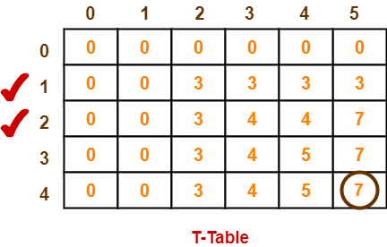
PRACTICE PROBLEM BASED ON 0/1 KNAPSACK PROBLEM Contd..

Slide 34
PRACTICE PROBLEM BASED ON 0/1 KNAPSACK PROBLEM Contd..
Identifying Items To Be Put Into Knapsack-
Following Step-04,
We mark the rows labelled “1” and “2”.
Thus, items that must be put into the knapsack to obtain the maximum value 7 are-
Item-1 and Item-2.

Slide 35
Knapsack Problem
You are given the following-
A knapsack (kind of shoulder bag) with limited weight capacity.
Few items each having some weight and value.
The problem states-
Which items should be placed into the knapsack such that:
The value or profit obtained by putting the items into the knapsack is maximum.
And the weight limit of the knapsack does not exceed.

Slide 36
Knapsack Problem

Slide 37
Knapsack Problem
Knapsack Problem Variants-
Knapsack problem has the following two variants:
1. Fractional Knapsack Problem
2. 0/1 Knapsack Problem
In this example, we will discuss about Fractional Knapsack Problem.

Slide 38
Fractional Knapsack Problem
In Fractional Knapsack Problem,
As the name suggests, items are divisible here.
We can even put the fraction of any item into the knapsack if taking the complete item is not possible.
It is solved using Greedy Method.

Slide 39
Fractional Knapsack Problem Using Greedy Method
Fractional knapsack problem is solved using greedy method in the following steps:
Step-01:
For each item, compute its value / weight ratio.
Step-02:
Arrange all the items in decreasing order of their value / weight ratio.
Step-03:
Start putting the items into the knapsack beginning from the item with the highest ratio.
Put as many items as you can into the knapsack.

Slide 40
Time Complexity
The main time taking step is the sorting of all items in decreasing order of their value / weight ratio.
If the items are already arranged in the required order, then while loop takes O(n) time.
The average time complexity of Quick Sort is O(nlogn).
Therefore, total time taken including the sort is O(nlogn).

Slide 41
PRACTICE PROBLEM BASED ON FRACTIONAL KNAPSACK PROBLEM
Problem:
For the given set of items and knapsack capacity = 60 kg, find the optimal solution for the fractional knapsack problem making use of greedy approach.

Slide 42
PROBLEM BASED ON FRACTIONAL KNAPSACK PROBLEM Contd..
Item | Weight | Value
1 | 5 | 30
2 | 10 | 40
3 | 15 | 45
4 | 22 | 77
5 | 25 | 90

Slide 43
PROBLEM BASED ON FRACTIONAL KNAPSACK PROBLEM Contd..
OR
Find the optimal solution for the fractional knapsack problem making use of greedy approach. Consider-
n = 5
w = 60 kg
(w1, w2, w3, w4, w5) = (5, 10, 15, 22, 25)
(b1, b2, b3, b4, b5) = (30, 40, 45, 77, 90)

Slide 44
PROBLEM BASED ON FRACTIONAL KNAPSACK PROBLEM Contd..
Solution-
Step-01:
Compute the value / weight ratio for each item.

Slide 45
PROBLEM BASED ON FRACTIONAL KNAPSACK PROBLEM Contd..
Items | Weight | Value | Ratio
1 | 5 | 30 | 6
2 | 10 | 40 | 4
3 | 15 | 45 | 3
4 | 22 | 77 | 3.5
5 | 25 | 90 | 3.6

Slide 46
PROBLEM BASED ON FRACTIONAL KNAPSACK PROBLEM Contd..
Step-02:
Sort all the items in decreasing order of their value / weight ratio-
I1 I2 I5 I4 I3
(6) (4) (3.6) (3.5) (3)
Step-03:
Start filling the knapsack by putting the items into it one by one.

Slide 47
PROBLEM BASED ON FRACTIONAL KNAPSACK PROBLEM Contd..
Knapsack Weight | Items in Knapsack | Cost
60 | Ø | 0
55 | I1 | 30
45 | I1, I2 | 70
20 | I1, I2, I5 | 160

Slide 48
PROBLEM BASED ON FRACTIONAL KNAPSACK PROBLEM Contd..
Now,
Knapsack weight left to be filled is 20 kg but item-4 has a weight of 22 kg.
Since in fractional knapsack problem, even the fraction of any item can be taken.
So, knapsack will contain the following items-
< I1 , I2 , I5 , (20/22) I4 >
Total cost of the knapsack
= 160 + (20/22) x 77
= 160 + 70
= 230 units

Slide 49
KNAPSACK PROBLEM
Important Note
Had the problem been a 0/1 knapsack problem, knapsack would contain the following items-
< I1 , I2 , I5 >
The knapsack’s total cost would be 160 units.

Slide 50
Kruskal’s Minimum Spanning Tree Algorithm
Spanning Tree Given a connected and undirected graph, a spanning tree of that graph is a sub-graph that is a tree and connects all the vertices together.
A single graph can have many different spanning trees.

Slide 51
Minimum Spanning Tree
A minimum spanning tree (MST) or minimum weight spanning tree for a weighted, connected and undirected graph is a spanning tree with weight less than or equal to the weight of every other spanning tree.
The weight of a spanning tree is the sum of weights given to each edge of the spanning tree.

Slide 52
Minimum Spanning Tree
A minimum spanning tree has (V – 1) edges where V is the number of vertices in the given graph.
Applications
- Road, cable and wire laying
- Network Routing
- Travelling Salesman Problem
- Cluster Analysis

Slide 53
Kruskal’s algorithm
The steps for finding MST using Kruskal’s algorithm
1. Sort all the edges in non-decreasing order of their weight. 2. Pick the smallest edge. Check if it forms a cycle with the spanning tree formed so far. If cycle is not formed, include this edge. Else, discard it. 3. Repeat step#2 until there are (V-1) edges in the spanning tree.

Slide 54
Kruskal’s algorithm Contd..
The algorithm is a Greedy Algorithm.
The Greedy Choice is to pick the smallest weight edge that does not cause a cycle in the MST constructed so far.
Let us understand it with an example: Consider the graph given below:

Slide 55
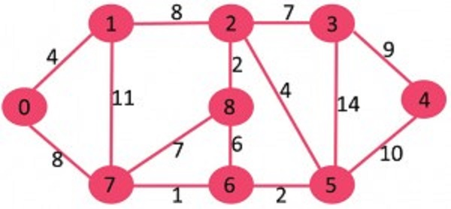
Kruskal’s algorithm Contd..
A Weighted Graph

Slide 56
Kruskal’s algorithm Contd..
The graph contains 9 vertices and 14 edges. So, the minimum spanning tree formed will be having (9 – 1) = 8 edges.
Sort them.
The edges after sorting is as follows:

Slide 57
Kruskal’s algorithm Contd..
Weight Src Dest
--------------------------
1 7 6
2 8 2
2 6 5
4 0 1
4 2 5
6 8 6
7 2 3
7 7 8

Slide 58
Kruskal’s algorithm Contd..
Weight Src Dest
8 0 7
8 1 2
9 3 4
10 5 4
11 1 7
14 3 5

Slide 59

Kruskal’s algorithm Contd..
Now, pick all edges one by one from sorted list of edges. 1. Pick edge 7-6: No cycle is formed, include it.

Slide 60
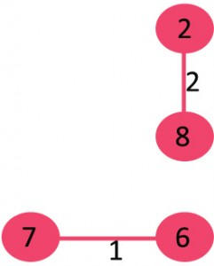
Kruskal’s algorithm Contd..
2. Pick edge 8-2: No cycle is formed, include it.

Slide 61
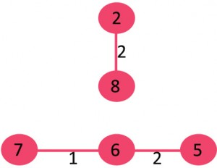
Kruskal’s algorithm Contd..
3. Pick edge 6-5: No cycle is formed, include it.

Slide 62
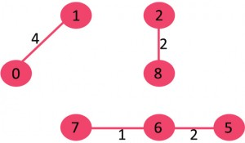
Kruskal’s algorithm Contd..
4. Pick edge 0-1: No cycle is formed, include it.

Slide 63
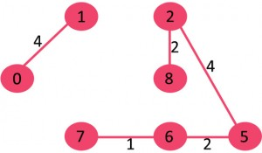
Kruskal’s algorithm Contd..
5. Pick edge 2-5: No cycle is formed, include it.

Slide 64
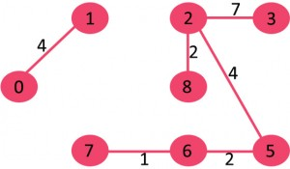
Kruskal’s algorithm Contd..
6. Pick edge 8-6: Since including this edge results in cycle, discard it.
7. Pick edge 2-3: No cycle is formed, include it.

Slide 65
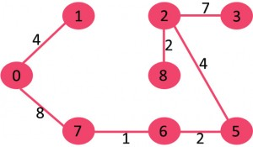
Kruskal’s algorithm Contd..
8. Pick edge 7-8: Since including this edge results in cycle, discard it.
9. Pick edge 0-7: No cycle is formed, include it.

Slide 66
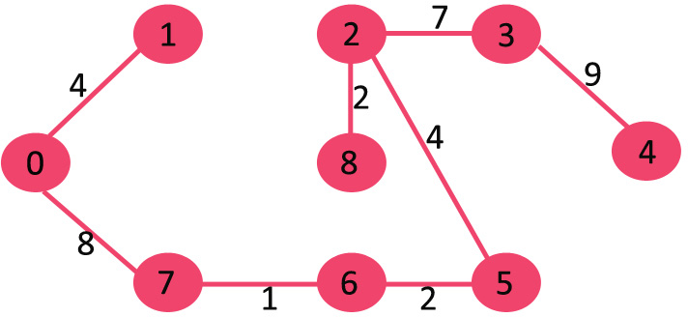
Kruskal’s algorithm Contd..
10. Pick edge 1-2: Since including this edge results in cycle, discard it.
11. Pick edge 3-4: No cycle is formed, include it.

Slide 67
Kruskal’s algorithm Contd..
Since the number of edges included equals
(V – 1), the algorithm stops here.
Time Complexity: O(ElogE) or O(ElogV).
Sorting of edges takes O(ELogE) time.
After sorting, we iterate through all edges and apply find-union algorithm.
The find and union operations can take atmost O(LogV) time. So overall complexity is O(ELogE + ELogV) time.
The value of E can be atmost O(V2), so O(LogV) are O(LogE) same.
Therefore, overall time complexity is O(ElogE) or O(ElogV)

Slide 68
Prim’s algorithm
Like Kruskal’s algorithm, Prim’s algorithm is also a Greedy algorithm.
It starts with an empty spanning tree.
The idea is to maintain two sets of vertices.
The first set contains the vertices already included in the MST, the other set contains the vertices not yet included.

Slide 69
Prim’s algorithm Contd..
At every step, it considers all the edges that connect the two sets, and picks the minimum weight edge from these edges.
After picking the edge, it moves the other endpoint of the edge to the set containing MST.

Slide 70
Prim’s algorithm Contd..
A group of edges that connects two set of vertices in a graph is called cut in graph theory.
So, at every step of Prim’s algorithm,
1. It finds a cut (of two sets, one contains the vertices already included in MST and other contains rest of the vertices).
2. It picks the minimum weight edge from the cut and includes this vertex to MST Set (the set that contains already included vertices).

Slide 71
Prim’s algorithm Contd..
The idea behind Prim’s algorithm is simple, a spanning tree means all vertices must be connected.
So the two disjoint subsets (discussed above) of vertices must be connected to make a Spanning Tree.
And they must be connected with the minimum weight edge to make it a Minimum Spanning Tree.

Slide 72
Prim’s algorithm Contd..
Algorithm 1) Create a set mstSet that keeps track of vertices already included in MST. 2) Assign a key value to all vertices in the input graph. Initialize all key values as INFINITE. Assign key value as 0 for the first vertex, so that it is picked first. 3) While mstSet doesn’t include all vertices ….a) Pick a vertex u which is not there in mstSet and has minimum key value. ….b) Include u to mstSet.

Slide 73
Prim’s algorithm Contd..
c) Update key value of all adjacent vertices of u.
To update the key values, iterate through all adjacent vertices.
For every adjacent vertex v, if weight of edge u-v is less than the previous key value of v, update the key value as weight of u-v.

Slide 74
Prim’s algorithm Contd..
The idea of using key values is to pick the minimum weight edge from cut.
The key values are used only for vertices which are not yet included in MST, the key value for these vertices indicate the minimum weight edges connecting them to the set of vertices included in MST.

Slide 75
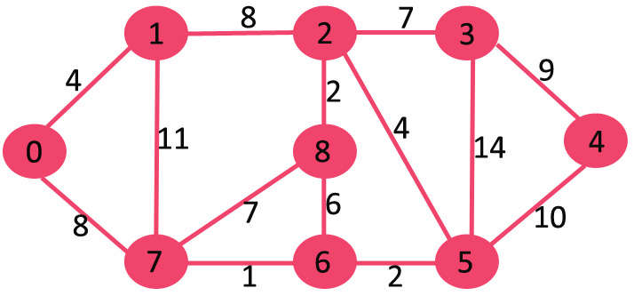
Prim’s algorithm Contd..
Let us understand with the following example:

Slide 76
Prim’s algorithm Contd..
The set mstSet is initially empty and keys assigned to vertices are {0, INF, INF, INF, INF, INF, INF, INF} where INF indicates infinite.
Now pick the vertex with the minimum key value. The vertex 0 is picked, include it in mstSet.

Slide 77
Prim’s algorithm Contd..
So mstSet becomes {0}. After including to mstSet, update key values of adjacent vertices.
Adjacent vertices of 0 are 1 and 7.
The key values of 1 and 7 are updated as 4 and 8. Following subgraph shows vertices and their key values, only the vertices with finite key values are shown.
The vertices included in MST are shown in green color.

Slide 78

Prim’s algorithm Contd..

Slide 79
Prim’s algorithm Contd..
Pick the vertex with minimum key value and not already included in MST (not in mstSET).
The vertex 1 is picked and added to mstSet. So mstSet now becomes {0, 1}.
Update the key values of adjacent vertices of 1.
The key value of vertex 2 becomes 8.

Slide 80
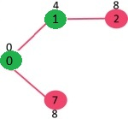
Prim’s algorithm Contd..

Slide 81
Prim’s algorithm Contd..
Pick the vertex with minimum key value and not already included in MST (not in mstSET).
We can either pick vertex 7 or vertex 2, let vertex 7 is picked.
So mstSet now becomes {0, 1, 7}.
Update the key values of adjacent vertices of 7.
The key value of vertex 6 and 8 becomes finite (1 and 7 respectively).

Slide 82
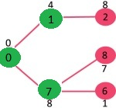
Prim’s algorithm Contd..

Slide 83
Prim’s algorithm Contd..
Pick the vertex with minimum key value and not already included in MST (not in mstSET).
Vertex 6 is picked.
So mstSet now becomes {0, 1, 7, 6}.
Update the key values of adjacent vertices of 6.
The key value of vertex 5 and 8 are updated.

Slide 84
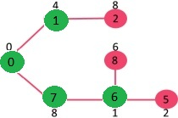
Prim’s algorithm Contd..

Slide 85
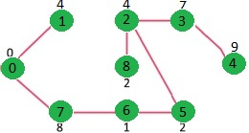
Prim’s algorithm Contd..
We repeat the above steps until mstSet includes all vertices of given graph.
Finally, we get the following graph.

Slide 86
Prim’s algorithm Contd..
Time Complexity of the above program is O(V^2).
If the input graph is represented using adjacency list, then the time complexity of Prim’s algorithm can be reduced to O(E log V) with the help of binary heap.

Slide 87
Search Techniques
DFS
BFS
Hill Climbing
Best First
A*
Genetic Algorithms
AO* search

Slide 88
Applications
Network Routing
Transportation
Cabling
Wiring
Travelling Salesman Problem

Slide 89
AI Problems
Missionaries and Cannibals Problem
Water Jug Problem
Eight Puzzle
Eight Queen’s Problem
Game Playing
Minimax Algorithm

Slide 90
Conclusions
Single source Single Destination.
Single Source multiple destinations.
Multiple source single destination.
Multiple sources multiple destinations.
Shortest Path Algorithms.

